Slide 1
Mental Health Treatment Committee
Cindy Haynes
Carlyle Johnson presenting

Slide 2

State Leader Honors Major for work at Durham Detention Facility

Slide 3
Durham County Detention Center
Medication Assisted Treatment Program (MAT)
As of November 9, 2021
  100 individuals on Suboxone
  58 individuals on Methadone
  10 in custody (6-Suboxone, 4-Methadone)
  15 to return to custody (6-Methadone)
Phase 2 (Induction launched on November 15, 2021
State approval to establish the Durham County Detention Center’s Opioid Treatment Program
For more information on the MAT Program at the Durham County Detention Center: Durham County Inmates Find Path to Recovery – Alliance Health
Notes:
DCSO Veteran Received Prestigious State Award
Durham, NC (Wednesday, November 24, 2021) -- Major Elijah Bazemore received the “North Carolina Dogwood Award” from State Attorney General Josh Stein yesterday in Raleigh. As cited, the award recognizes his “extraordinary demonstration of excellence, dedication, and creativity in pursuing community solutions to our state’s most pressing issues, in alignment with the North Carolina Department of Justice’s mission of protecting the people of North Carolina.”
Major Bazemore was recognized for his pioneering work coordinating the "Medical Assistance Treatment" program at the Durham County Detention Facility. The first of its kind in North Carolina, MAT has helped detainees get treatment to fight opioid use disorder resulting in reducing recidivism.

Slide 4
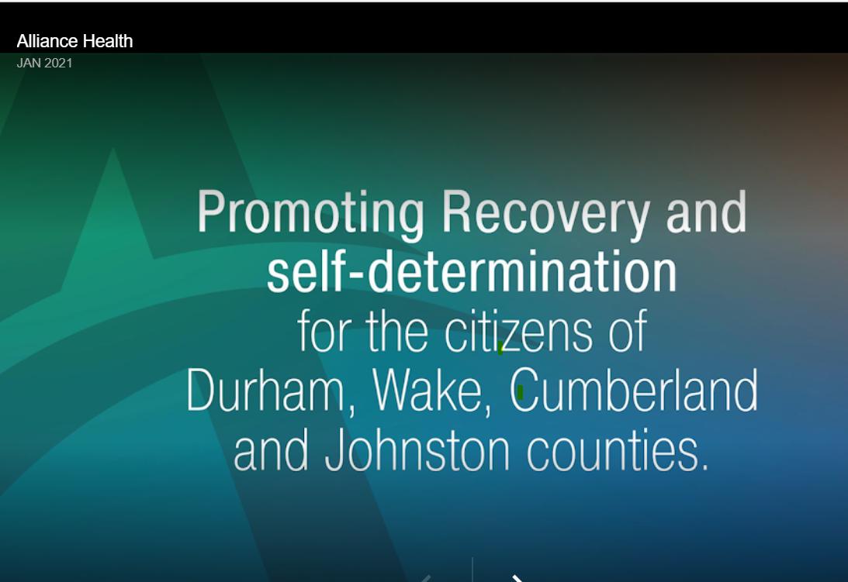
Alliance Health
Tailored Plan
  Adding Orange & Mecklenburg Counties
Funding support for the Detention Center to support SUD housing post discharge from Detention Center
Exploring opportunity to provide funding support for SUD housing CLC grant participants (DRRC)
Proving Naloxone for community partners

Slide 5
Opioid Follow-up with Community Paramedics and Peer Navigators

