Slide 1

Durham County
Community Linkages to Care
Peer Support Program

Slide 2
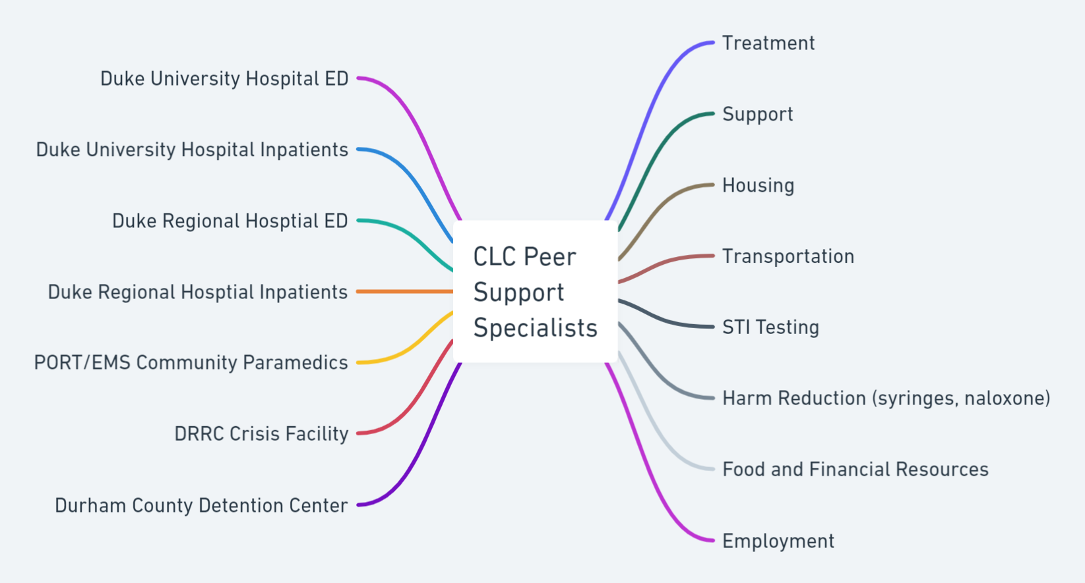
New Participants Per Month = 15-20 Total Contacts Per Month = 50-70

Slide 3
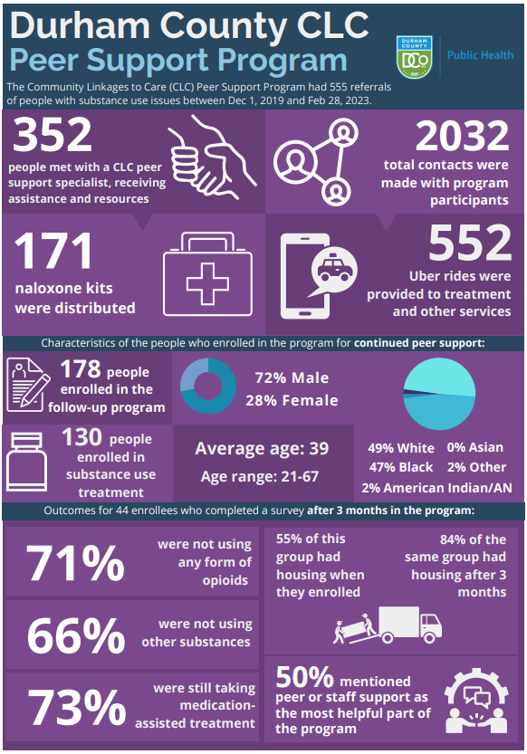

Slide 4
Black | Black | White | White | Other | Other | Missing | Missing | American Indian/Alaskan Native | American Indian/Alaskan Native
Male: 18-24 | Female: 18-24 | Male: 18-24 | Female: 18-24 | Male: 18-24 | Female: 18-24 | Male: 18-24 | Male: 18-24 | Male: 18-24 | Female: 18-24
1 | 0 | 2 | 1 | 1 | 0 | 1 | 2 | 0 | 0
Male: 25-34 | Female: 25-34 | Male: 25-34 | Female: 25-34 | Male: 25-34 | Female: 25-34 | Male: 25-34 | Female: 25-34 | Male: 25-34 | Female: 25-34
13 | 9 | 18 | 8 | 1 | 0 | 10 | 4 | 1 | 0
Male: 35-44 | Female: 35-44 | Male: 35-44 | Female: 35-44 | Male: 35-44 | Female: 35-44 | Male: 35-44 | Female: 35-44 | Male: 35-44 | Female: 35-44
18 | 4 | 23 | 7 | 2 | 0 | 13 | 2 | 1 | 1
Male: 45-54 | Female: 45-54 | Male: 45-54 | Female: 45-54 | Male: 45-54 | Female: 45-54 | Male: 45-54 | Female: 45-54 | Male: 45-54 | Female: 45-54
11 | 7 | 11 | 3 | 2 | 0 | 3 | 0 | 0 | 0
Male: 55-64 | Female: 55-64 | Male: 55-64 | Female: 55-64 | Male: 55-64 | Female: 55-64 | Male: 55-64 | Female: 55-64 | Male: 55-64 | Female: 55-64
9 | 2 | 2 | 2 | 0 | 0 | 2 | 0 | 0 | 0

Slide 5
EMS Opioid Calls in Durham:
July 2021 Through December 2022
Black Male: < 18 | Black Male: 18-24 | Black Male: 25-34 | Black Male: 35-44 | Black Male: 45-54 | Black Male: 55-64 | Black Male: 65 and older |  | White Male: < 18 | White Male: 18-24 | White Male: 25-34 | White Male: 35-44 | White Male: 45-54 | White Male: 55-64 | White Male: 65 and older
2 | 19 | 98 | 129 | 125 | 88 | 37 |  | 0 | 18 | 133 | 88 | 58 | 21 | 11
Total Black Male = 498
Total White Male = 329

Slide 6
Recruitment by Race

