Slide 1
Multidisciplinary Teams

Slide 2
MULTIDISCIPLINARY TEAMS
Multidisciplinary Team Roles
MHU Role
Make initial contact with individual
Secure the scene and assure scene stays safe during entire call
Perform Emergency Detention or courtesy rides if necessary
Paramedic Role
Provide complete medical assessment of individual
Provide on scene safety assessment of environment if necessary
Clinician Role
De-escalate and provide complete mental health assessment
Connect to longer term resources as needed/appropriate
Peer Support/Follow Up Role
Connect to wrap around services (benefits, substance use support, medication management)
Establish long term rapport with the patient

Slide 3
Evolution of Multidisciplinary Teams
Team Name | Year Established with STCC | Agencies Involved | Threat/ 911 High Utilizer | High Volume Emergency Detention | Follow up | Response | Peer Support | Medical Support | LE Support
PICC Program for Intensive Care Coordination | 2019 | SAPD SAFD CHCS |  | X | X |  |  | X | X
CCSI Chronic Crisis Stabilization Initiative | 2019 | SAPD CHCS | X |  | X | X |  |  | X
SMART Specialized Multidisciplinary Alternate Response Team | 2020 | BCSO Acadian, Bexar Co EMS, CHCS |  |  | X | X | X | X | X
SA-CORE San Antonio Community Outreach & Resiliency Effort | 2021 | SAPD SAFD CHCS |  |  | X | X |  | X | X

Slide 5
Program Details
Launched July 2019
Provide ongoing, intensive case management for citizens with multiple emergency detentions and/or high use of Psychiatric Emergency Services
Connection into existing or new outpatient services
Connection to social resources
Build independence within the individual in order to help them become less dependent on crisis services

Slide 6
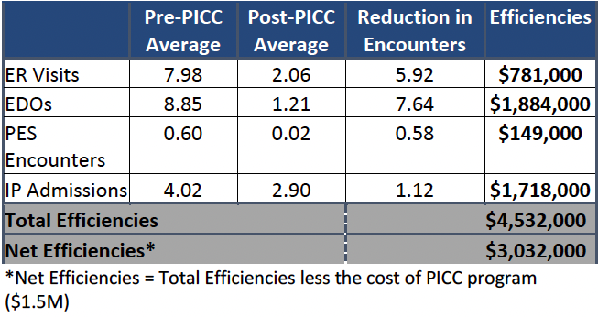
Capital Healthcare Planning &
Meadows Mental Health Policy Institute Analysis (PICC): 2021

Slide 7
PROGRAM FOR INTENSIVE CARE COORDINATION 2021
Added to PICC
February 2021
Patient Profile:
50-Year-old male
Schizoaffective, Bipolar Type
Type 2 Diabetes
Patient Utilization: January ‘20- December ‘21:
PD Contacts – 289
Emergency Detentions – 9
EMS: PICC and EMS Runs – 73
PICC Contacts 12/1/20-12/1/21:
Phone with Patient – 25
In Person with Patient – 81
Phone with Other – 6
In Person with Other – 7
Doctor Appointment with Patient – 8
Total PICC Contacts: 127
STCC Program Utilization
Law Enforcement Navigation
1 ED
1 ED
1 ED
1 ED
April ‘21
May ‘21
June ‘21
July ‘21
Aug ‘21
Sept ‘21
Oct ‘21
Nov ‘21
Dec ‘21
Jan ‘22
Moved into Group Home
Utilized Crisis Line
Monthly provider appointment
Monthly provider appointment
Completed Intake with CTS
Monthly provider appointment
PICC met with patient and CHCS becomes payee
Follow up with Dr. IT
Birth Certificated obtained through PICC
Monthly provider appointment
Monthly provider appointment
PICC delivered food from charity
Follow up with Dr. IT
Moved home with family
Monthly provider appointment
ID Recovery Completed
Successfully Discharged From PICC
Monthly provider appointment
Next Steps: Transition back to PEC for continued treatment and continue to maintain stable housing.

Slide 8
PROGRAM FOR INTENSIVE CARE COORDINATION
Team Details
Team Members:
4 Qualified Mental Health Professionals
2 Mental Health Unit Officers
2 Mobile Integrated Healthcare Paramedics
Additional staff:
.5 LVN
.25 Clinic Administrator
.5 Front Desk Clerk
.5 Psychiatrist
PICC works 6 days a week from 8:30am- 5:30pm and has someone dedicated to on call coverage 24/7

Slide 10
STRAC/COSA contract, December 2019
Intervene in a co-response model for high threat, or high utilizers of emergency services
Stabilization on scene
Connection to existing or new outpatient services
Program Details

Slide 11
CHRONIC CRISIS STABILIZATION INITIATIVE
Team Details
Team Members:
3 Crisis Response Clinicians
Each assigned to a Mental Health Unit Officer for the shift
Additional staff:
.5 Behavioral Health Supervisor
.10 Clinic Administrator
SAPD MHU Leadership
CCSI Clinicians work 5 days a week, 7am – 5pm
Mental Health Unit Officers work 7 days a week, 7am – 11pm

Slide 12
CHRONIC CRISIS STABILIZATION INITIATIVE
Threat Assessment & High Interest Follow Up
CCSI follows up with individuals identified as potential community concerns identified by a variety referral sources. They utilize a matrix developed to follow and characterize individuals with whom they work.
Notes:
THREAT ASSESSMENT & HIGH INTEREST FOLLOW UP

Slide 13
Questions?

