Slide 1

Industrial User Permit Compliance 101

Slide 2
Introduction the Compliance Team
Responsibilities Include:
Reporting to NC DEQ on behalf of the Compliance Program.
Compliance Judgment of all Industrial Users and Enforcement of Compliance Program.
Maintain Headworks Analysis Allocation Table for Triangle Wastewater Treatment Plant (TWWTP).
Manage TWWTP Laboratory and maintain compliance with NPDES.
Amy Moore
Compliance Manager

Slide 3

Introduction the Compliance Team
Responsibilities Include:
Writing Industrial User Permits.
Industry Inspections.
Industrial Waste Survey of TWWTP Basin.
Coordinates with Project Management on new construction and building upfits for Industrial Users in the TWWTP Basin.
Laura Melton
Pretreatment Project Coordinator

Slide 4
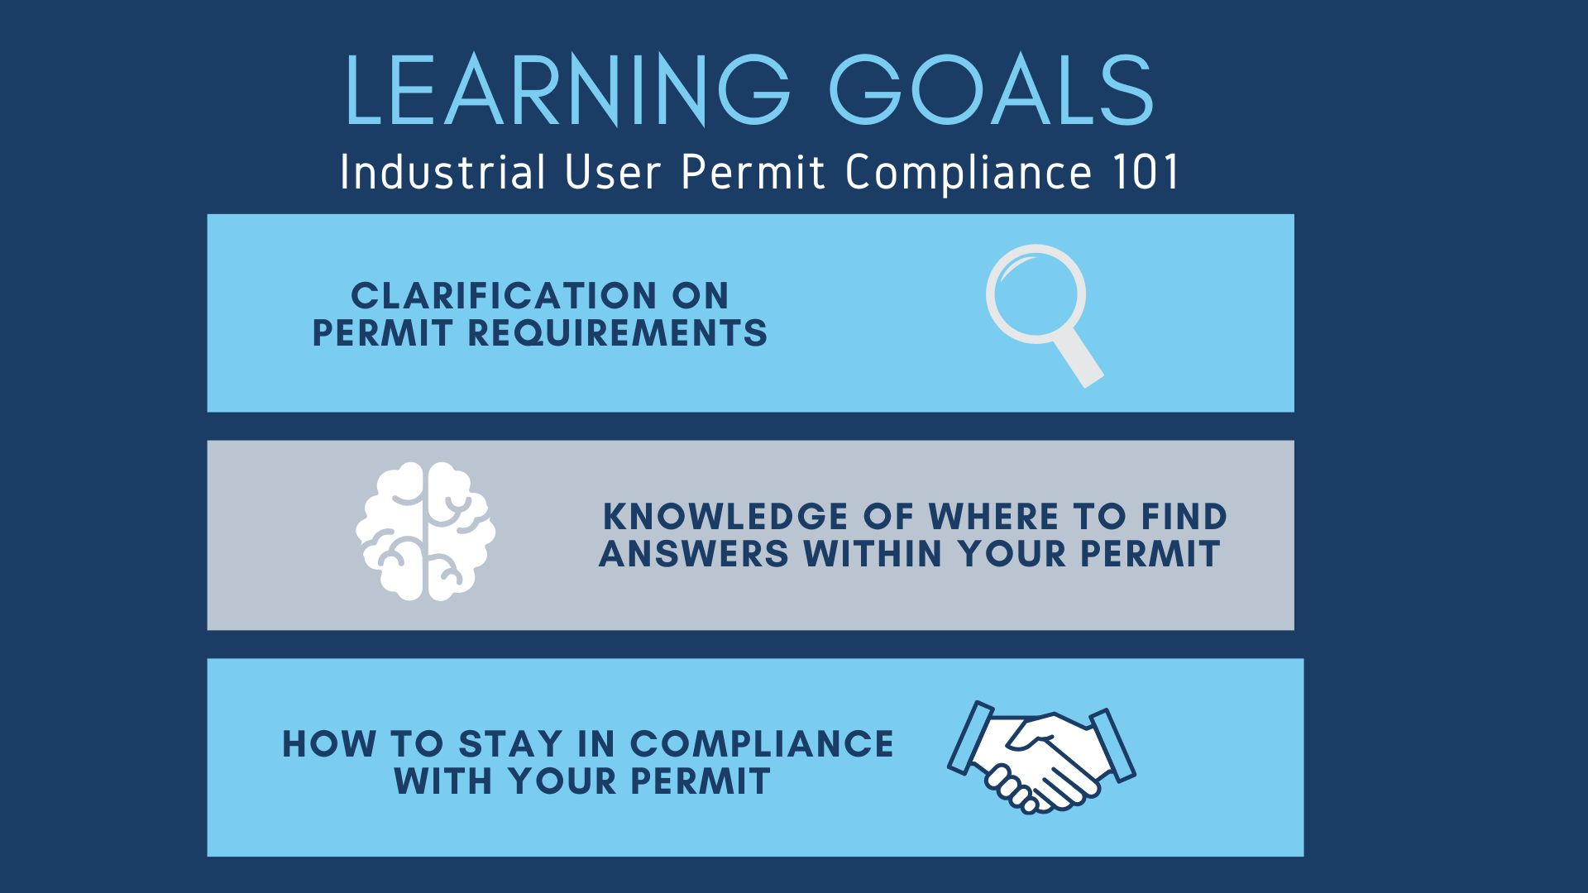

Slide 5
Agenda
1. Purpose of Industrial Pretreatment Program
2. Types of Industrial User Permits
3. Compliance Program Scope
4. Industrial User Permit Anatomy
5. Common Permit Violations
6. Compliance Website Overview
7. Box.com IUP Collaboration Folders
8. Timeline for Submitting Compliance Forms

Slide 6
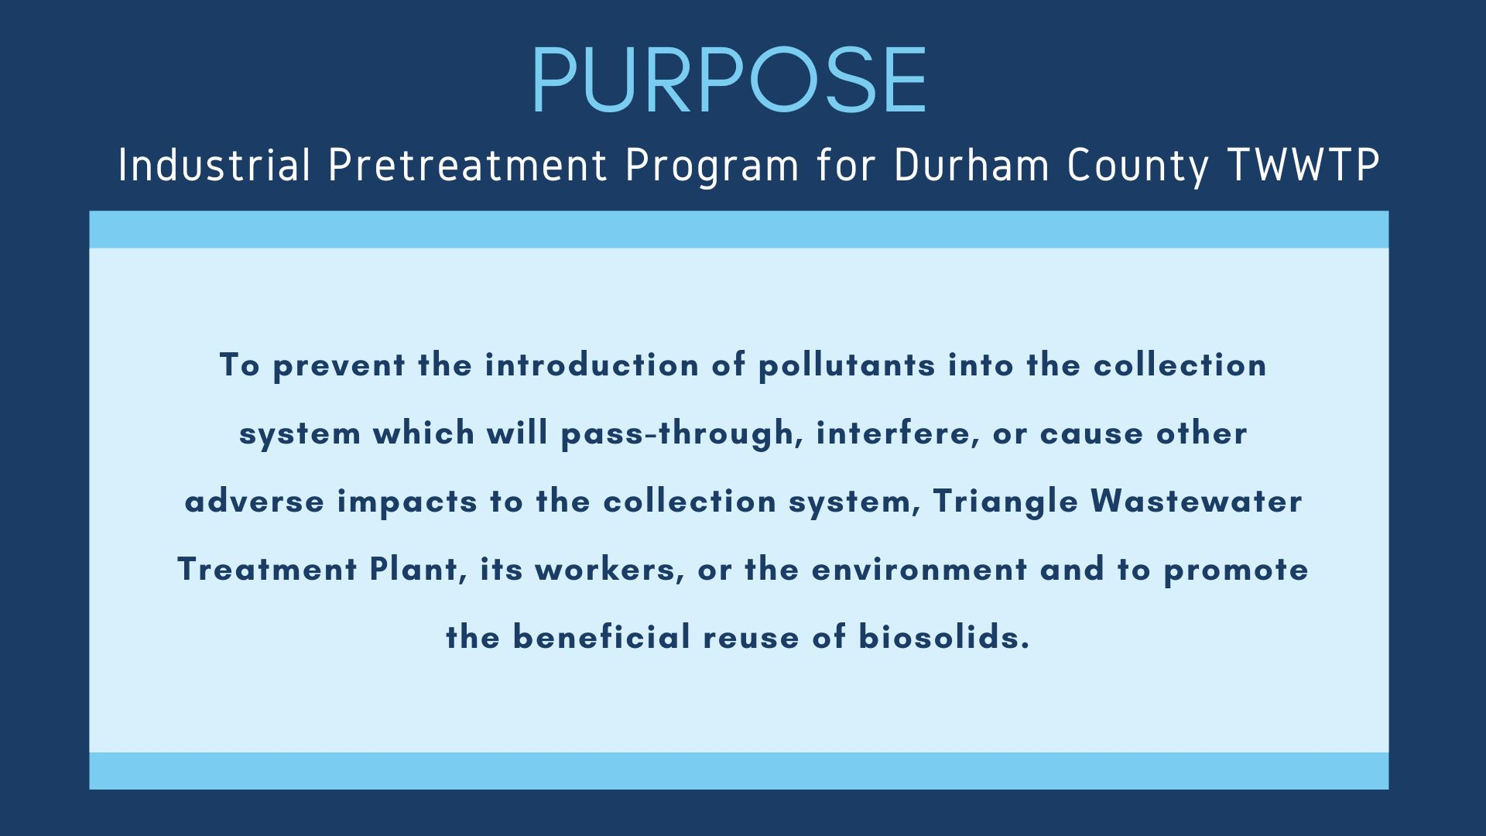

Slide 7
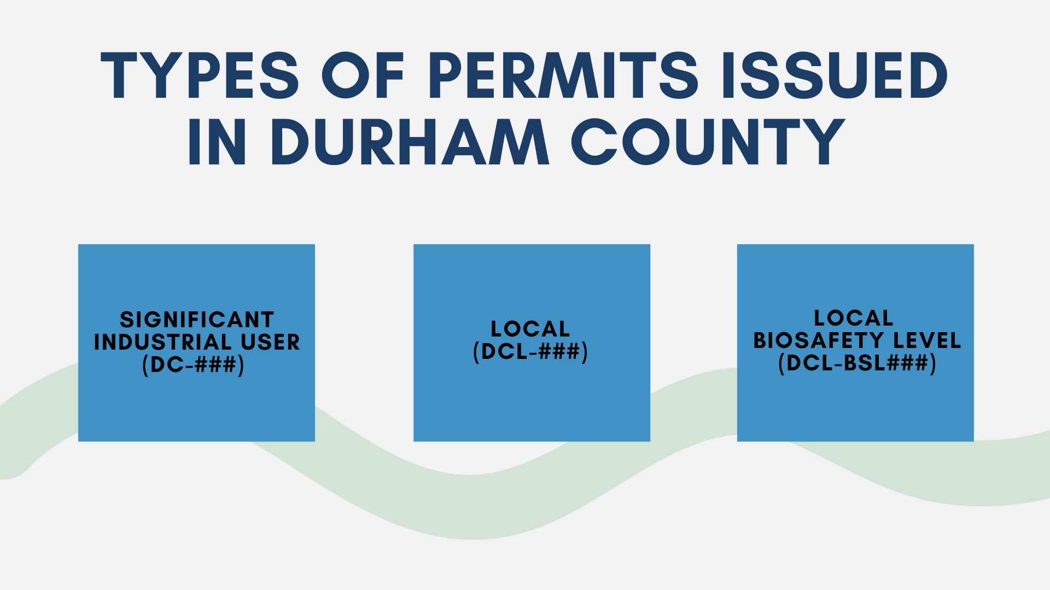

Slide 8
Significant Industrial User (DC-###)
Significant Industrial User or SIU. Any user of the county wastewater system who:
25,000 gallons of Flow
≥5% P.O.C
Categorical Pretreatment Standard
Control Authority Judgement
Notes:
Has an average daily process wastewater flow of 25,000 gallons or more unless otherwise designated by the Control Authority in accordance with 15A NCAC 02H .0907(b); or
Contributes process wastewater which makes up five percent or more of the NPDES or Non-discharge permitted flow limit or organic capacity of the POTW treatment plant. In this context, organic capacity refers to BOD, TSS, and Ammonia, unless otherwise designated by the Control Authority in accordance with 15A NCAC 02H .0907(b); or
Is required to meet a national categorical pretreatment standard, unless otherwise designated by the Control Authority in accordance with 15A NCAC 02H .0907(b); or
Is designated as such by the Control Authority on the basis that the User has a reasonable potential for adversely affecting the POTW’s operation, or for violating any Pretreatment Standard or requirement, or for contributing to violations of the POTW’s effluent limitations and conditions in its NPDES or non-discharge permit, or for limiting the POTW’s sludge disposal options.

Slide 9
Local (DCL-###)
Local Industrial User Permits are issued to users who do not meet the definition of “Significant Industrial User” but, who, in the opinion of the Durham County Utility Division, still need to be permitted and/or monitored.
Local Industrial User (LIU) Permits are not a part of the federally mandated pretreatment program. LIU Permits may contain pollutant limits and/or local pollutant allocations. All limits and allocations are established on a case-by-case basis and are based on the Maximum Allowable Headworks Loadings (MAHL) of the POTW.
The Utility Division may require any user to apply for a LIU Permit.
Notes:
Criteria used in making a decision to issue a local permit may include:
Estimated wastewater strength, characteristics and total flow.
Activity and/or processes on the premises.
Type and/or amount of raw materials and chemicals used or stored at the facility.
Potential for spills which could impact the collection system, treatment processes, and sludge disposal options.
Any pollutant discharge concentration that is 1% of the Maximum Allowable Headworks Loading (MAHL) of the POTW will contain a permit limit.
Any pollutant discharge concentration that is 0.5% of the Maximum Allowable Headworks Loading (MAHL) of the POTW will contain a permit monitoring requirement.
Anyone issued a Local Industrial User Permit will be monitored at least annually for mercury.

Slide 10
Local Biosafety Level (DCL-BSL###)
Many Local and SIU permits include a Biosafety Level (BSL) component.
Local BSL permits are for standalone tenant spaces where monitoring an industry’s isolated discharge would be difficult.
The primary goal of the Local BSL permits is to protect the health and safety of all Utilities Division workers by ensuring biological materials are decontaminated according to the current approved methods.
Two approved decontamination methods:
  Chemical treatment of biological liquids, with bleach
  Autoclave treatment of liquids

Slide 11
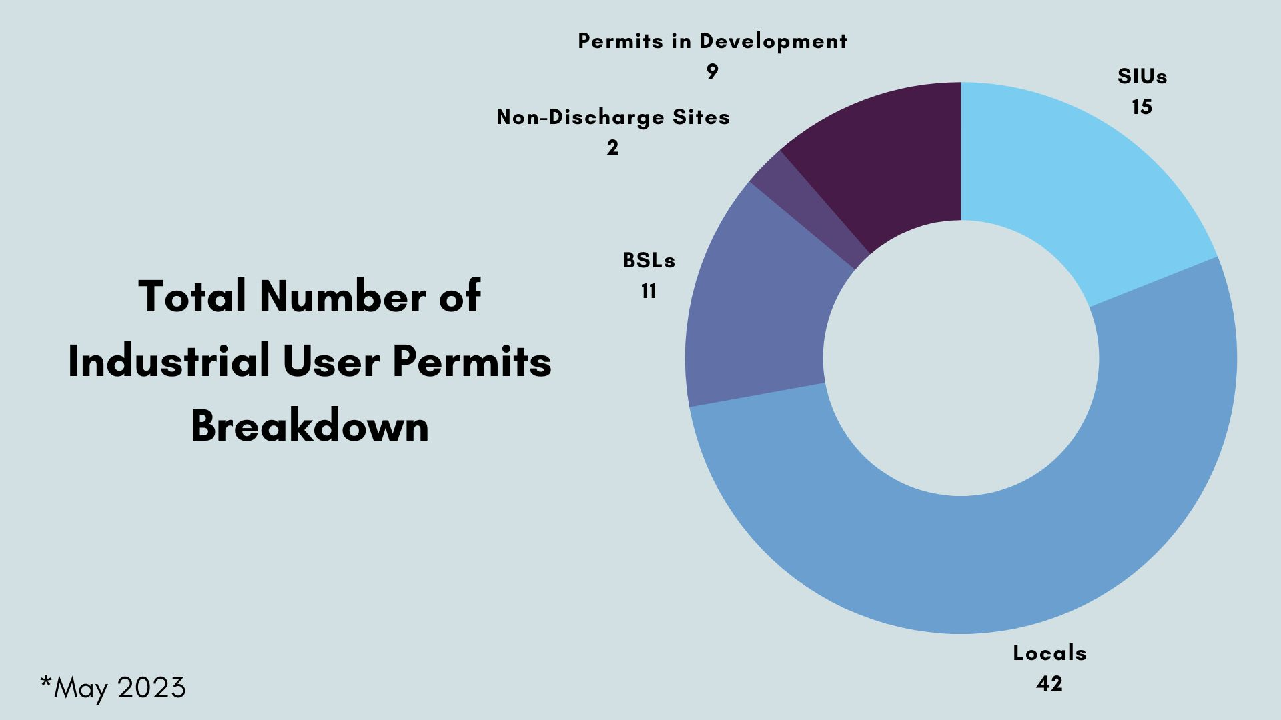

Slide 12
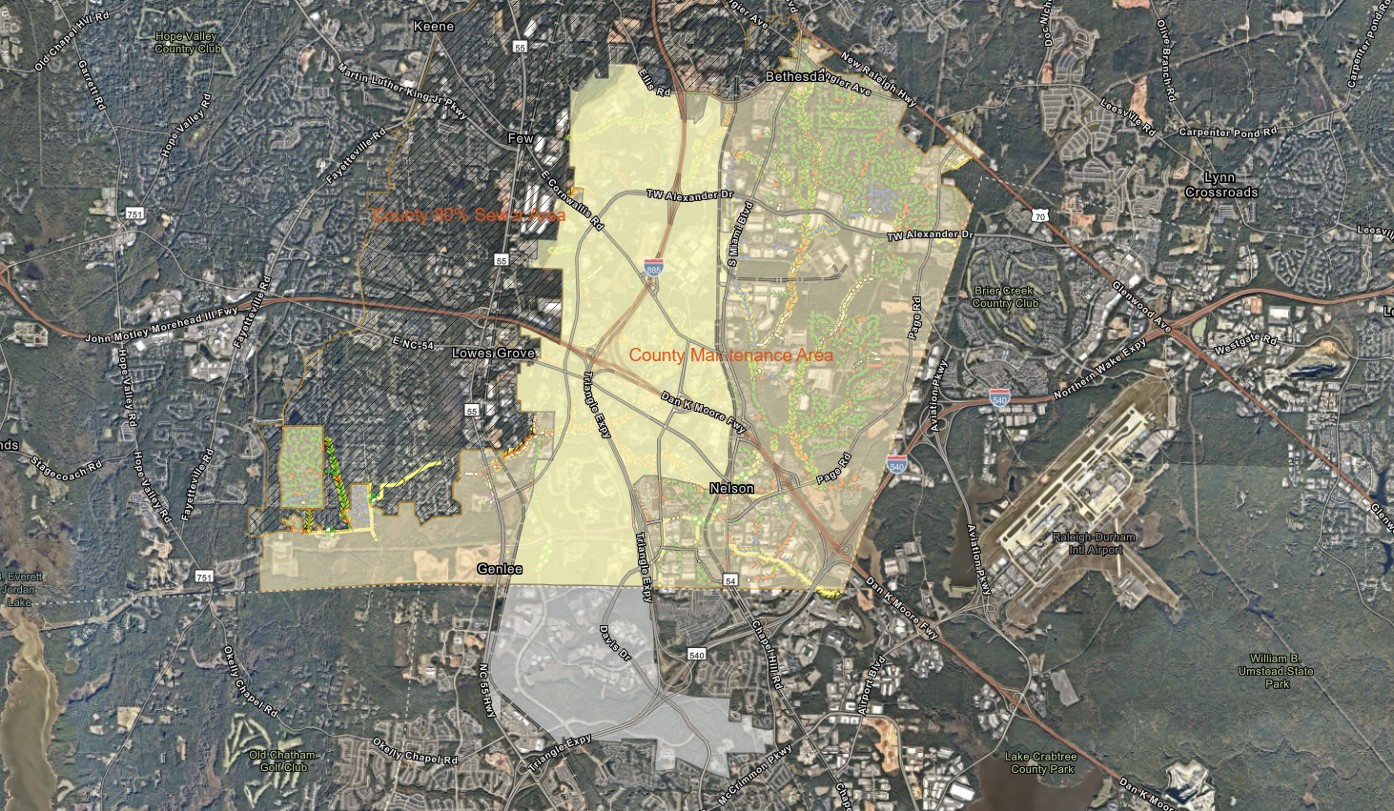

Slide 13
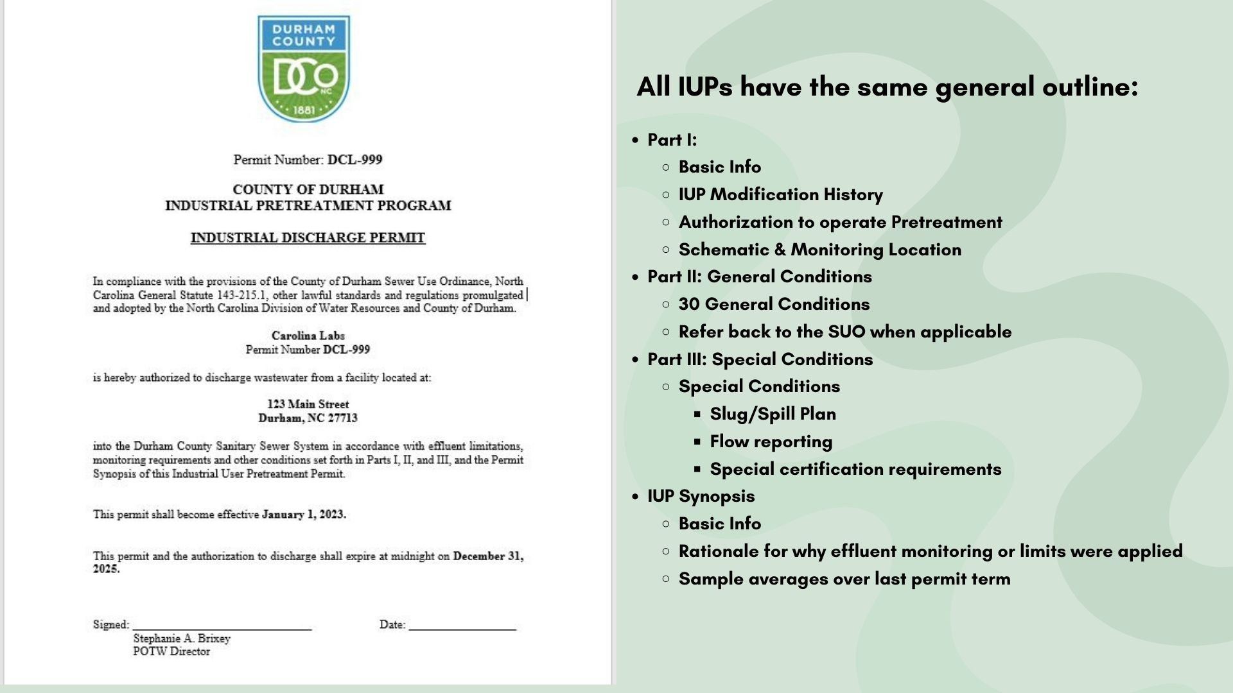

Slide 14
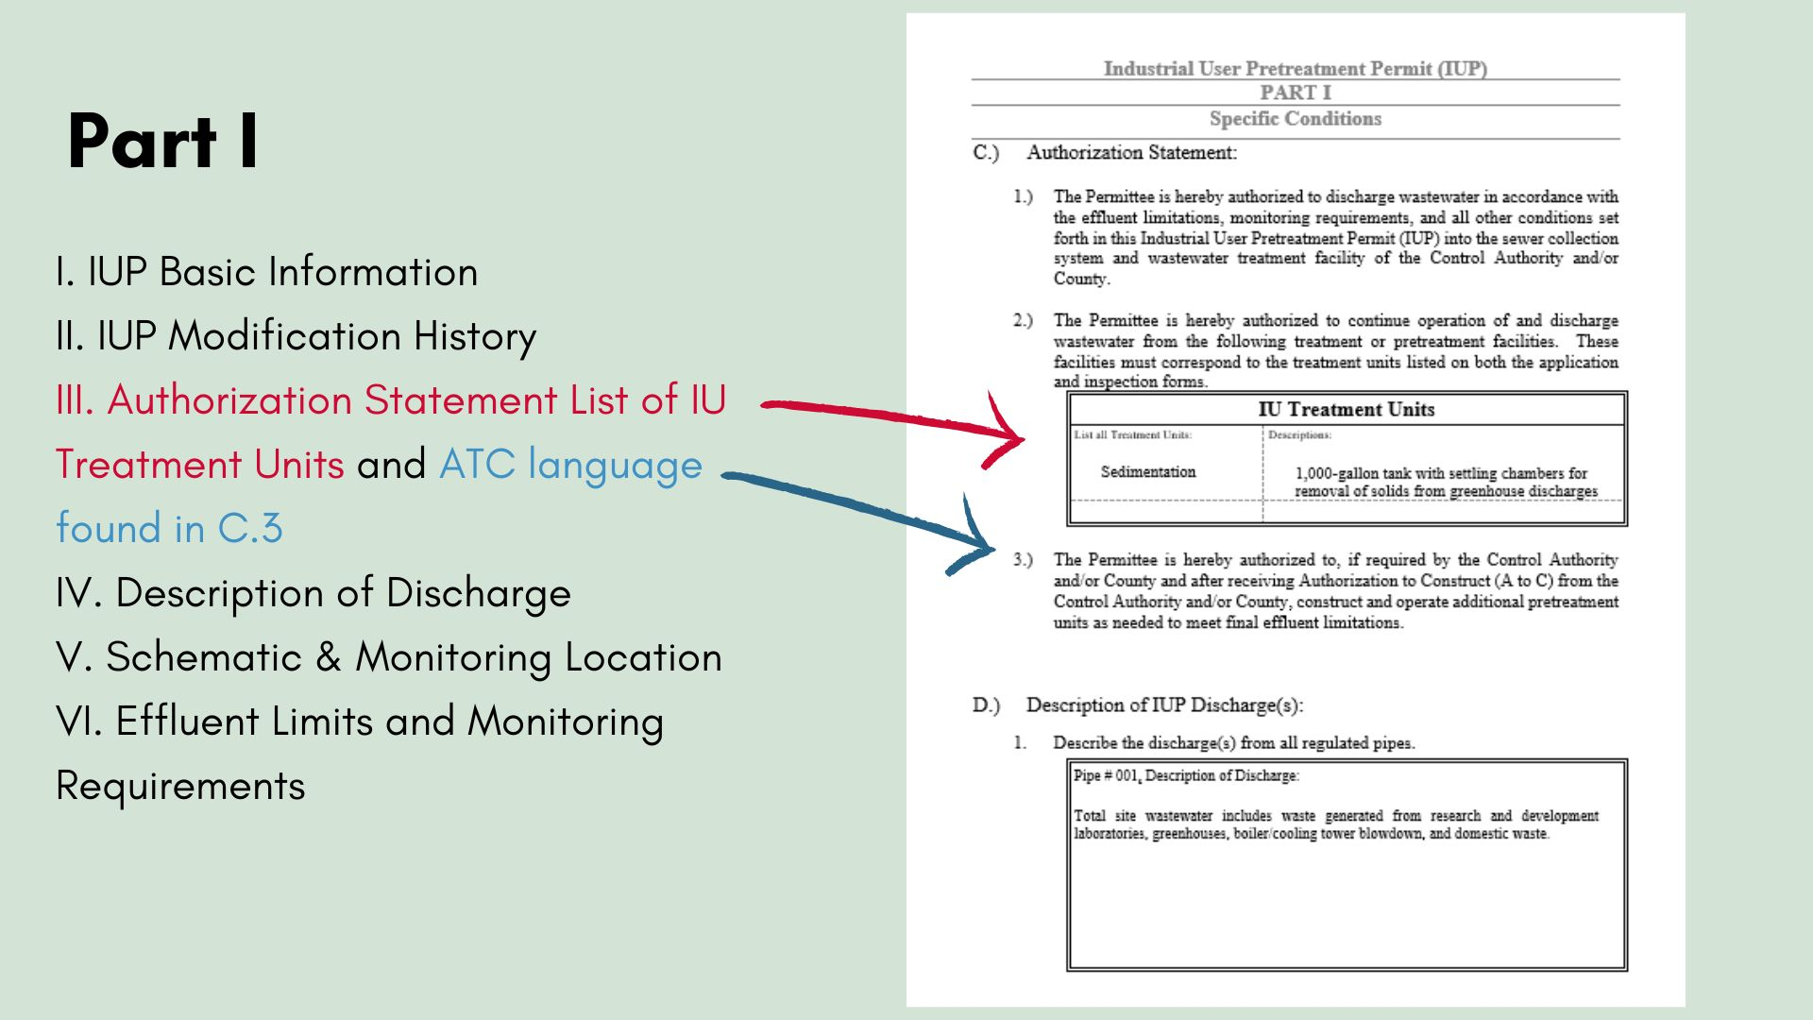

Slide 15
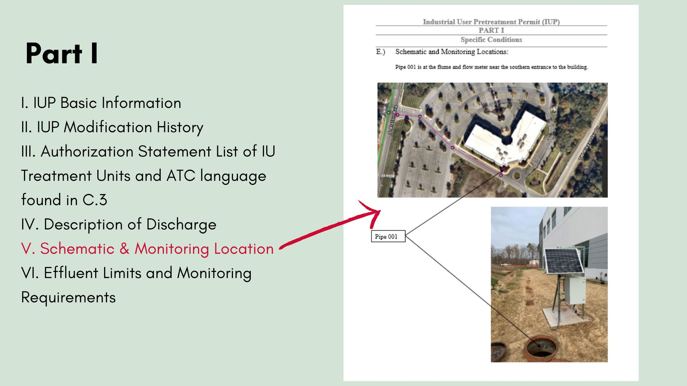

Slide 16
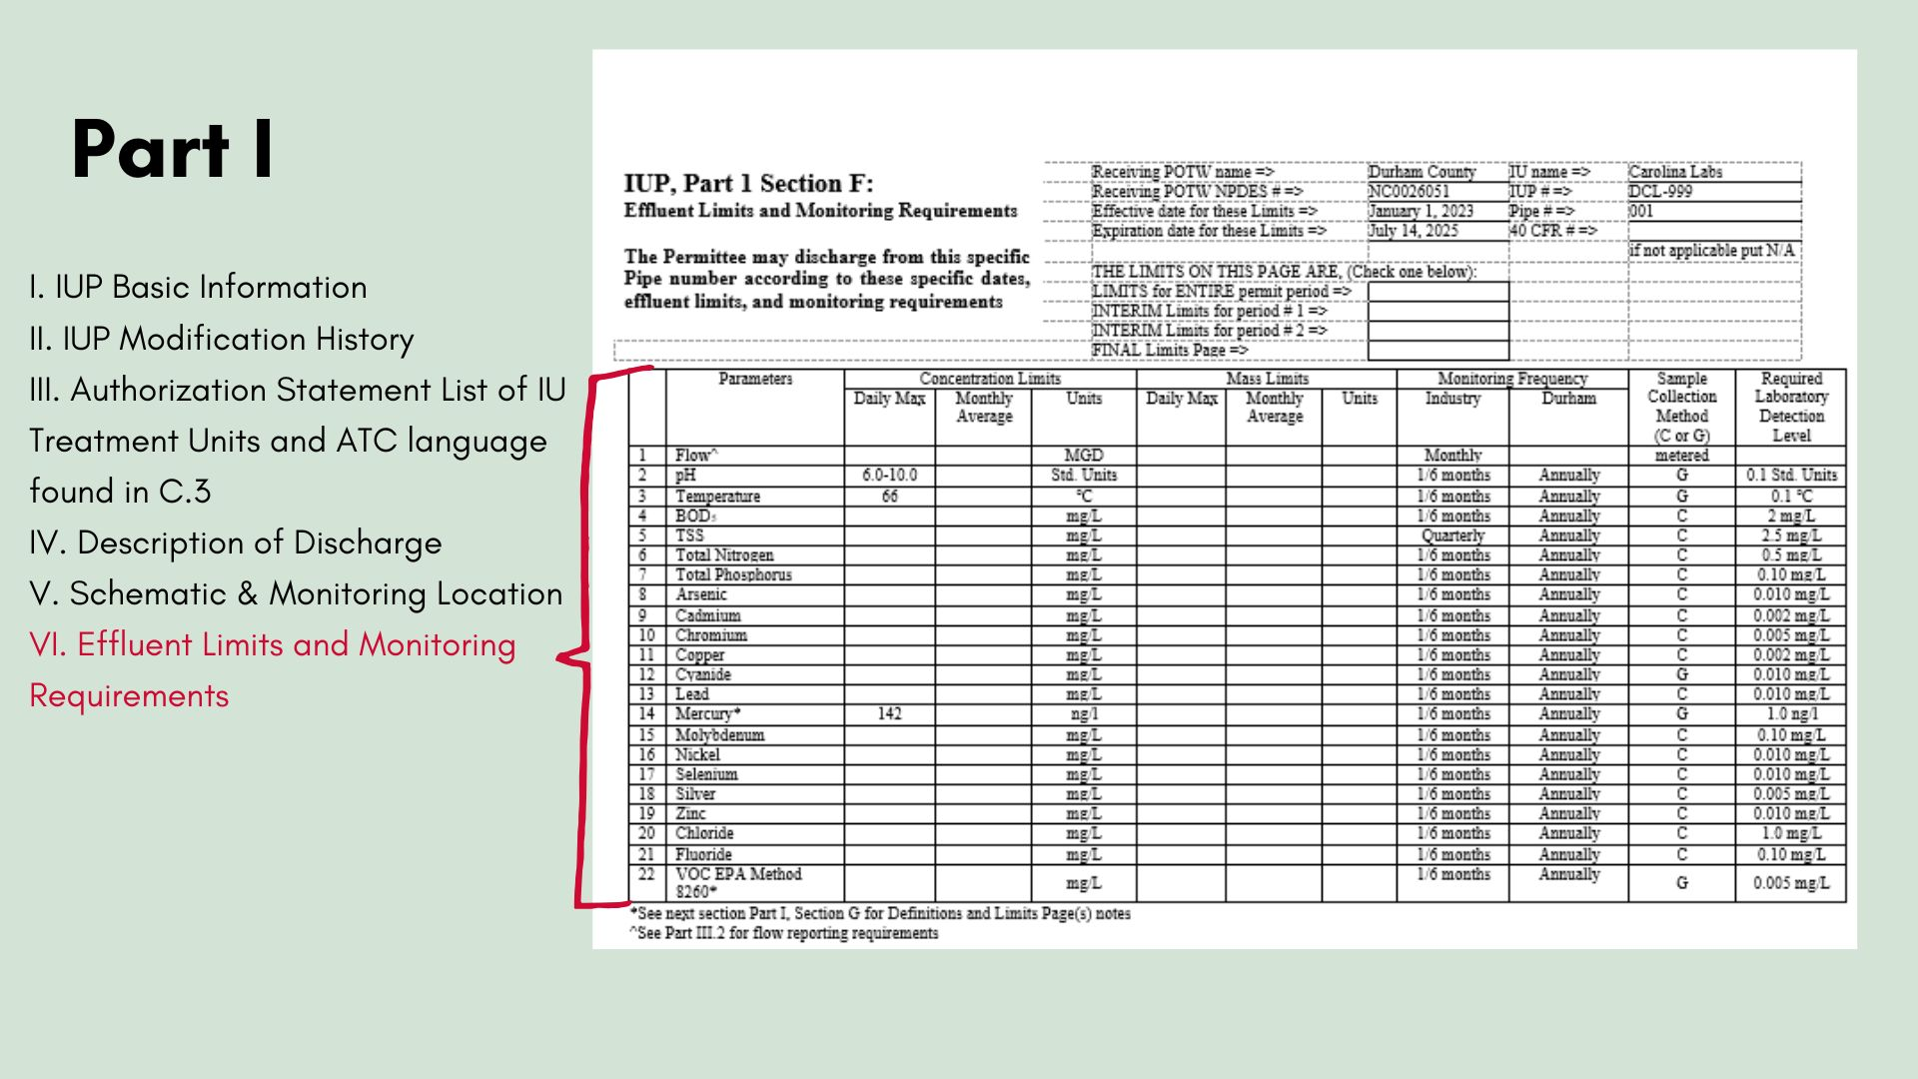

Slide 17
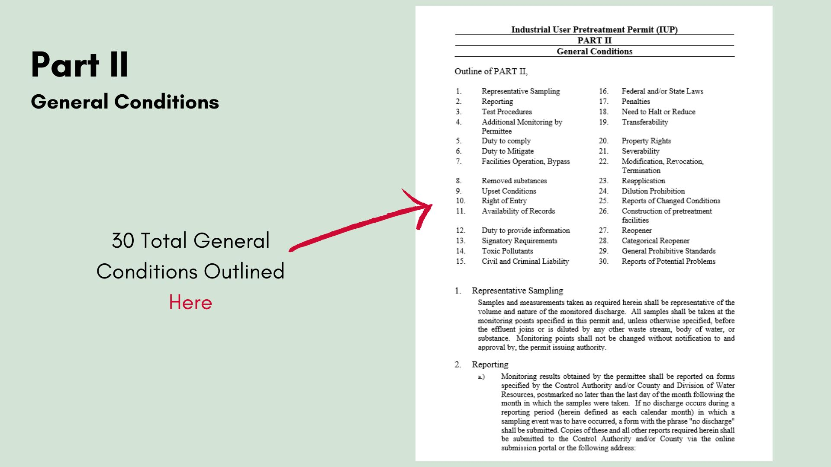

Slide 18
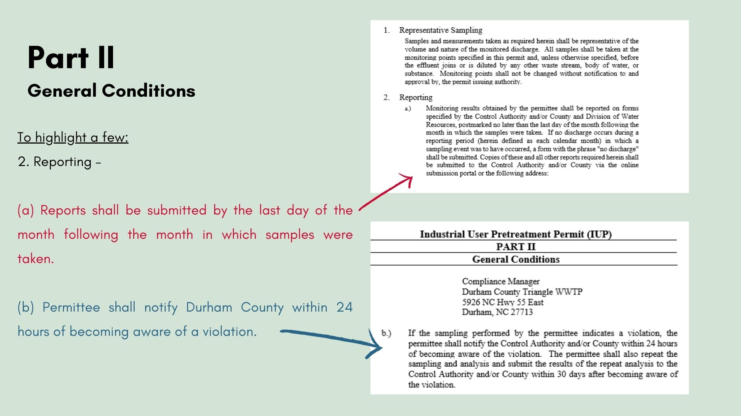

Slide 19
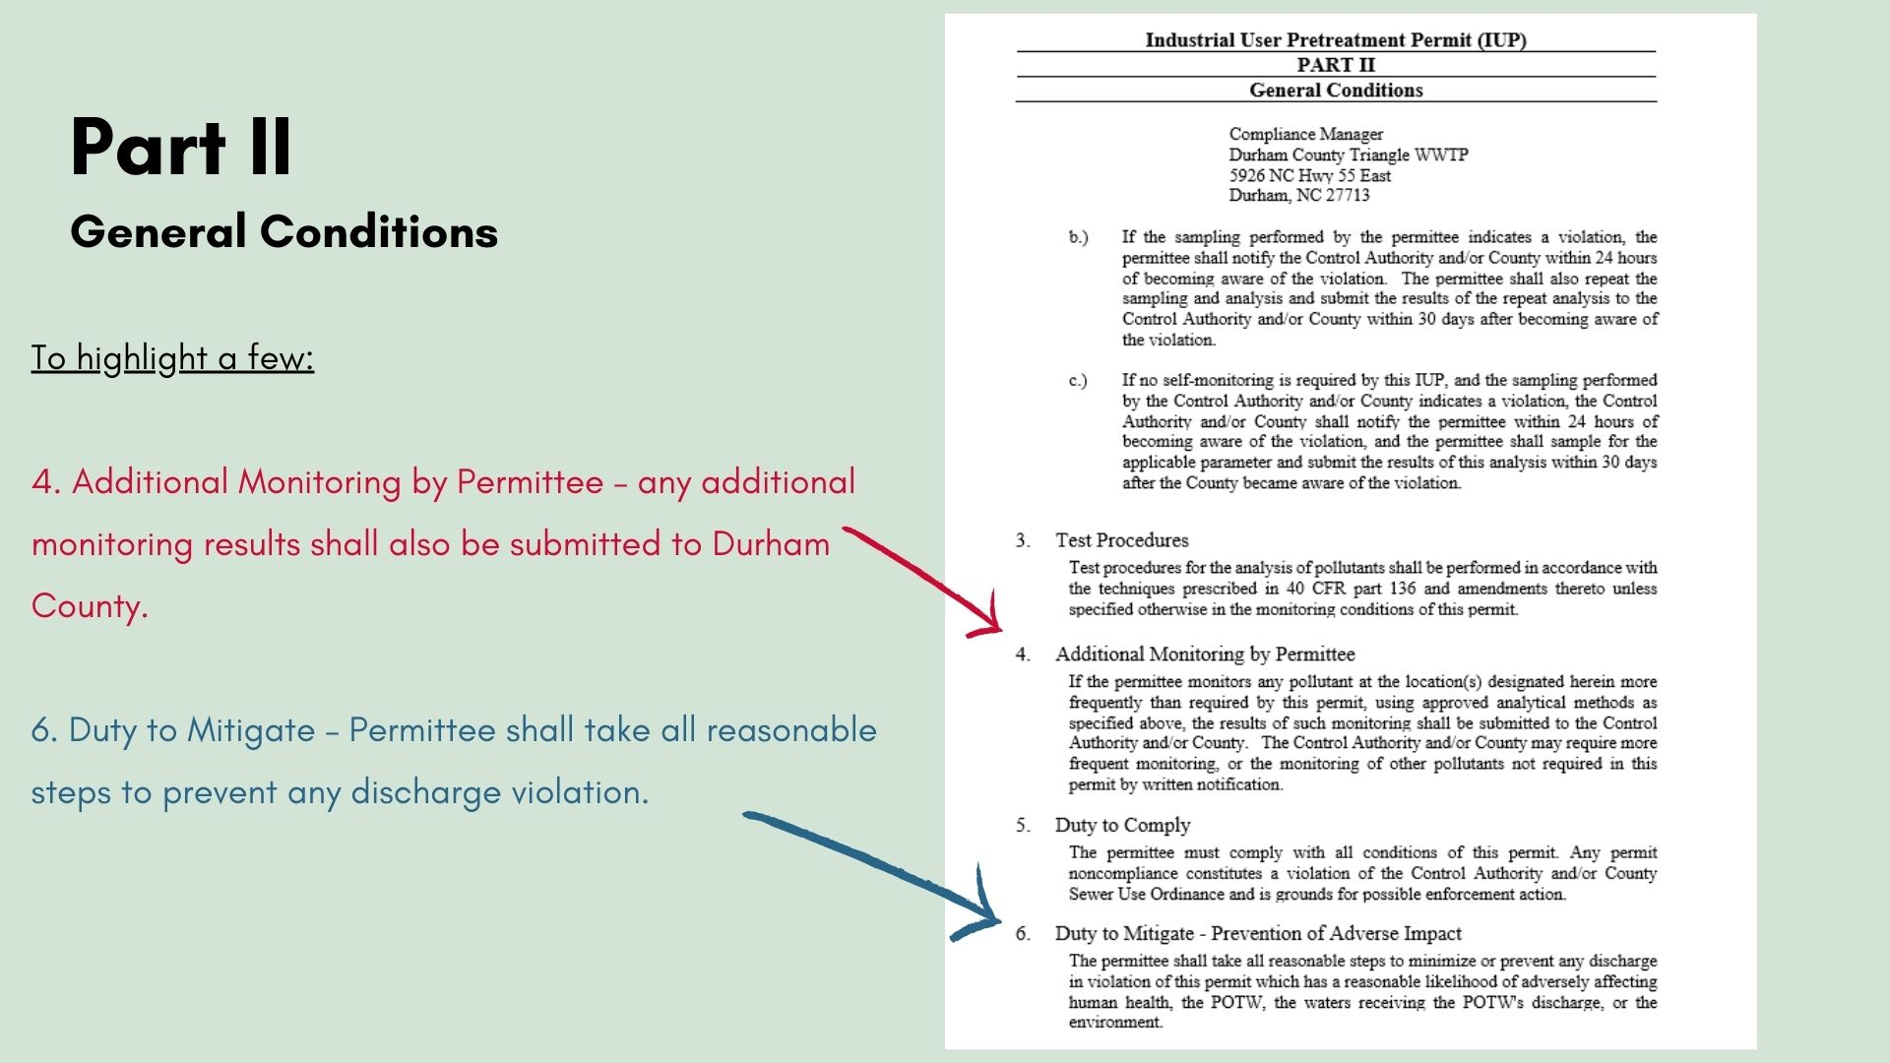

Slide 20
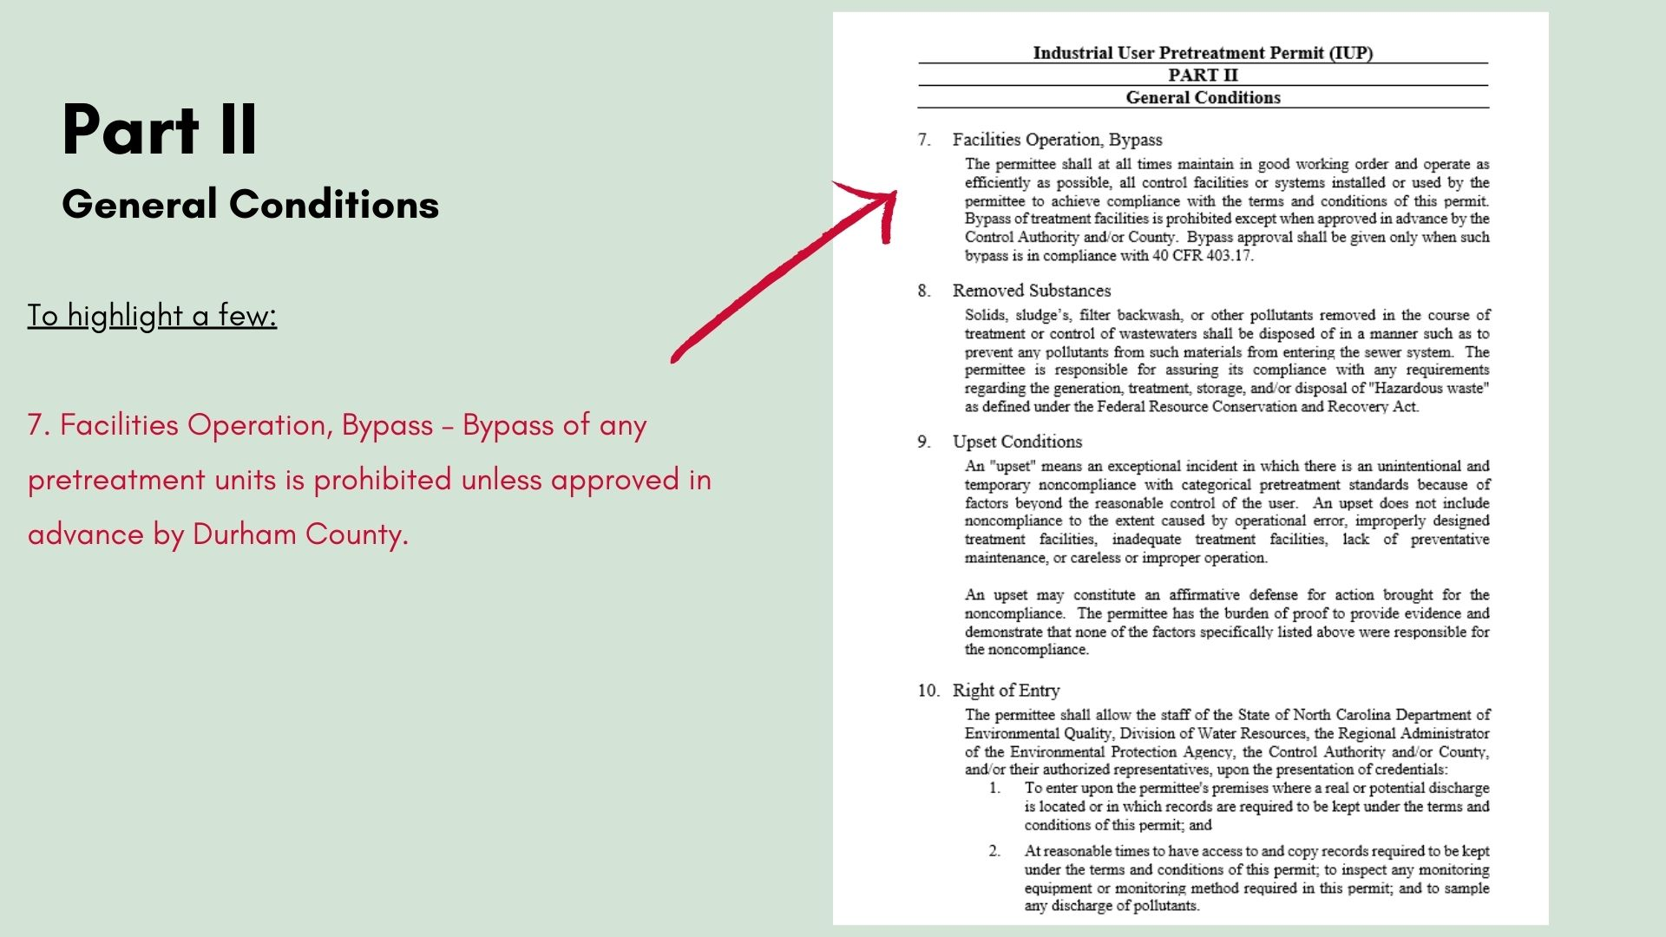

Slide 21
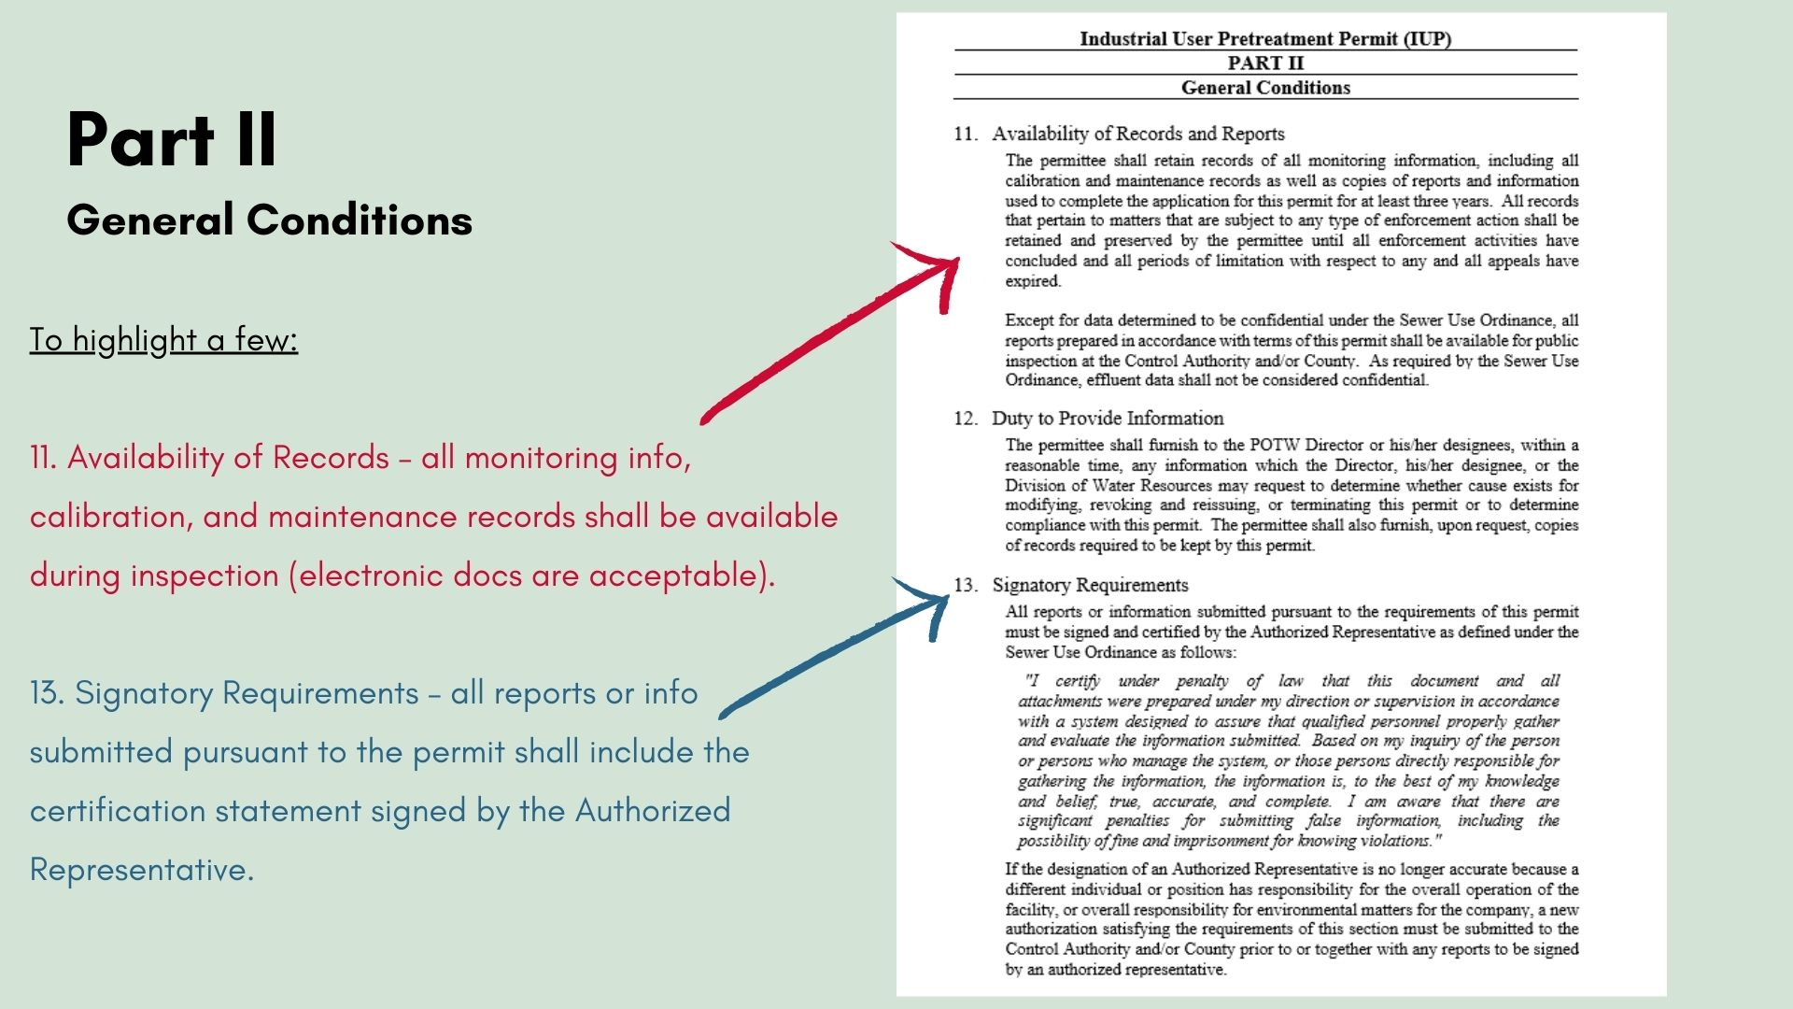

Slide 22
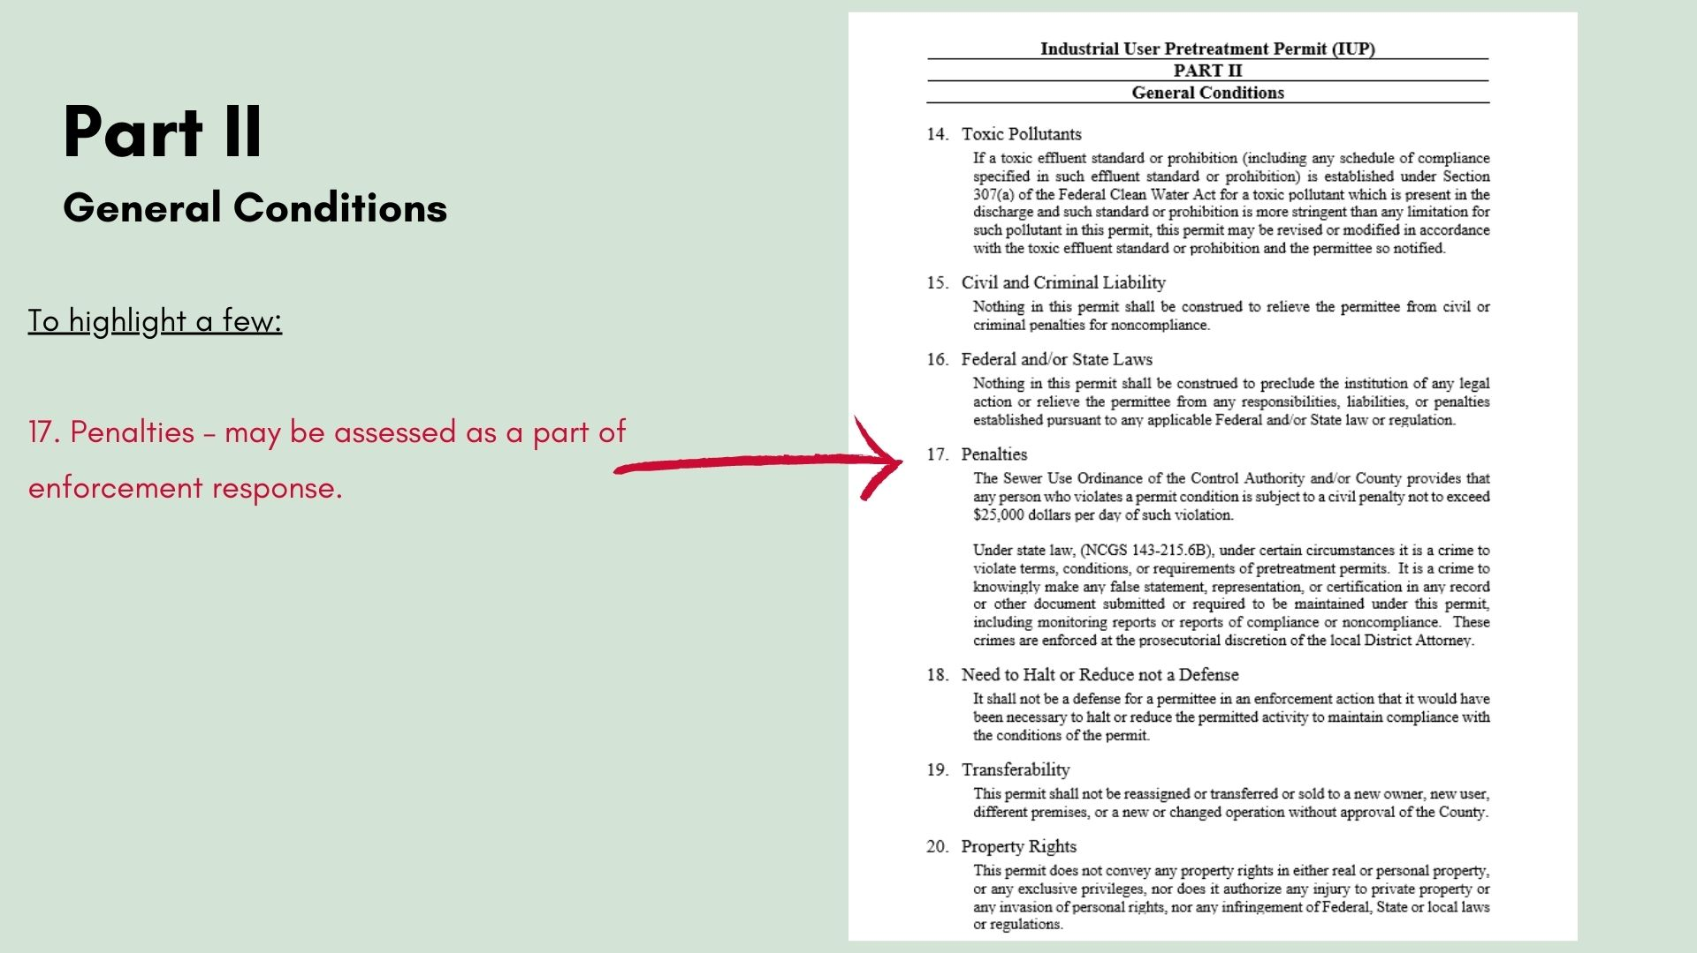

Slide 23
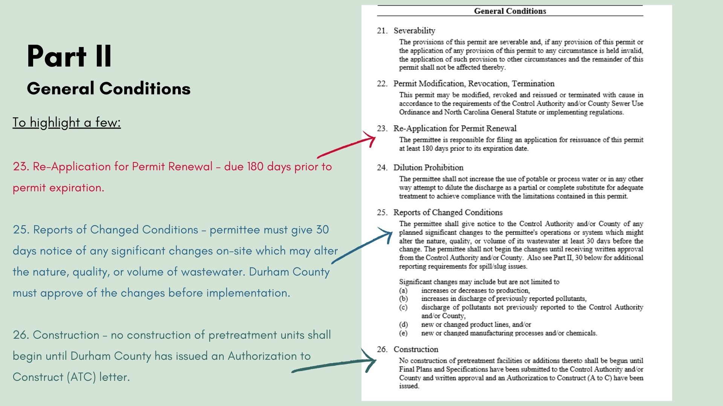

Slide 24
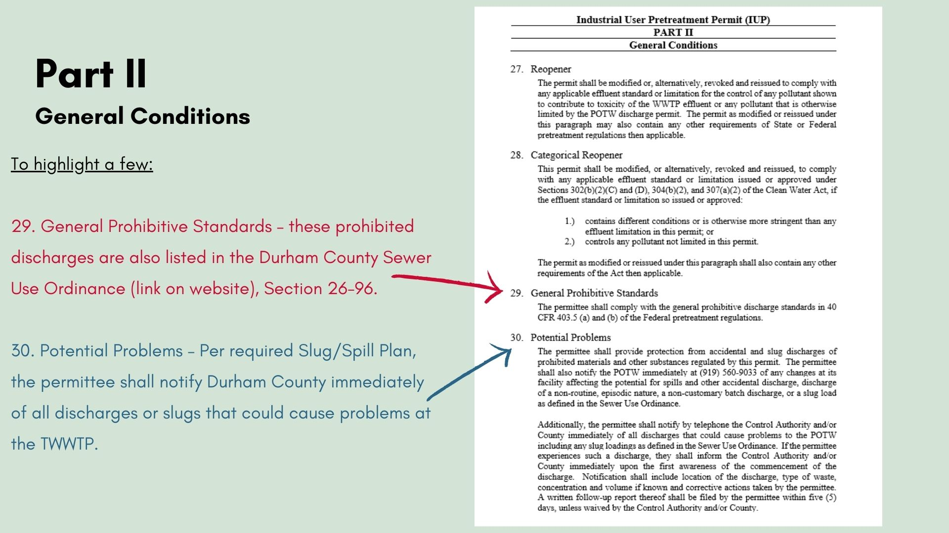

Slide 25
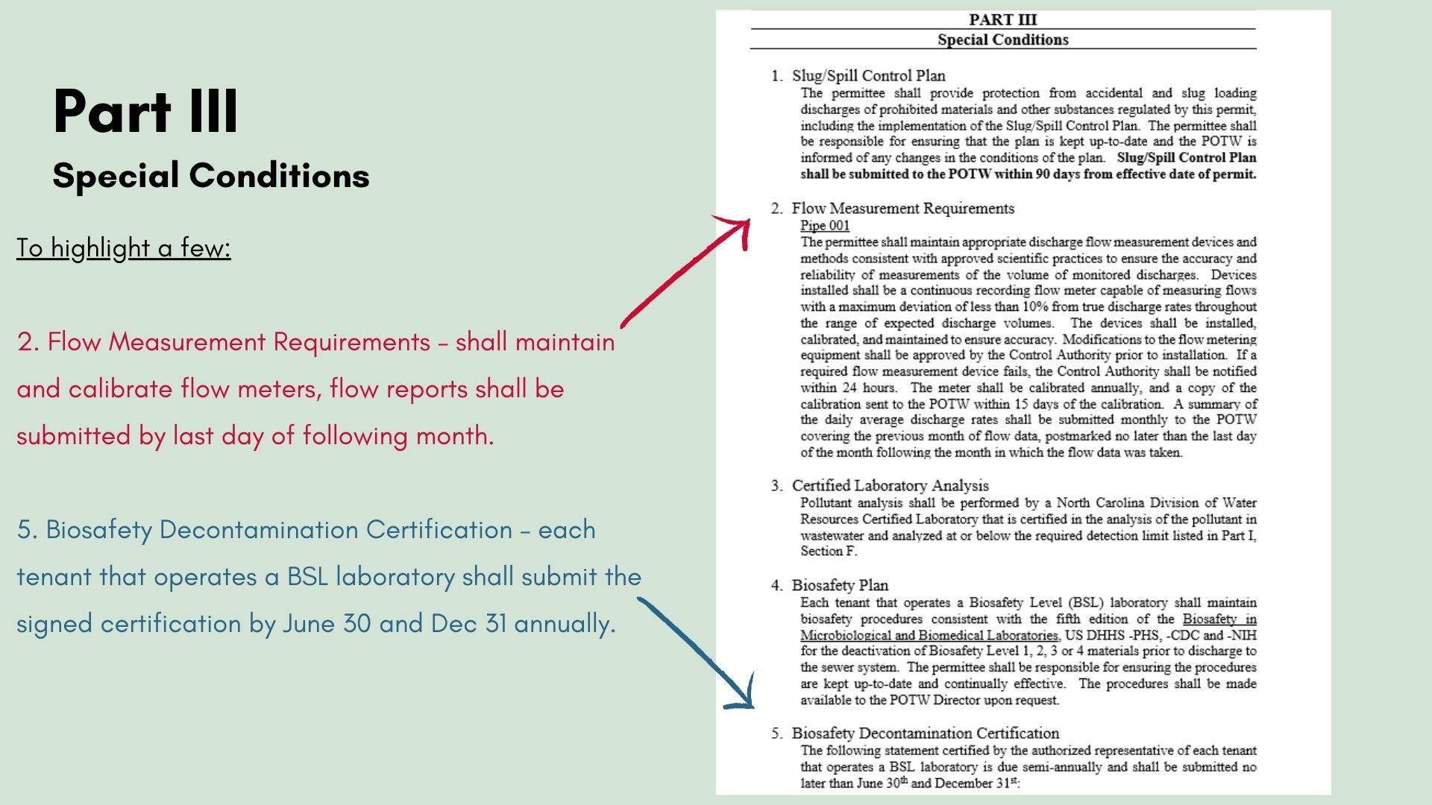

Slide 26
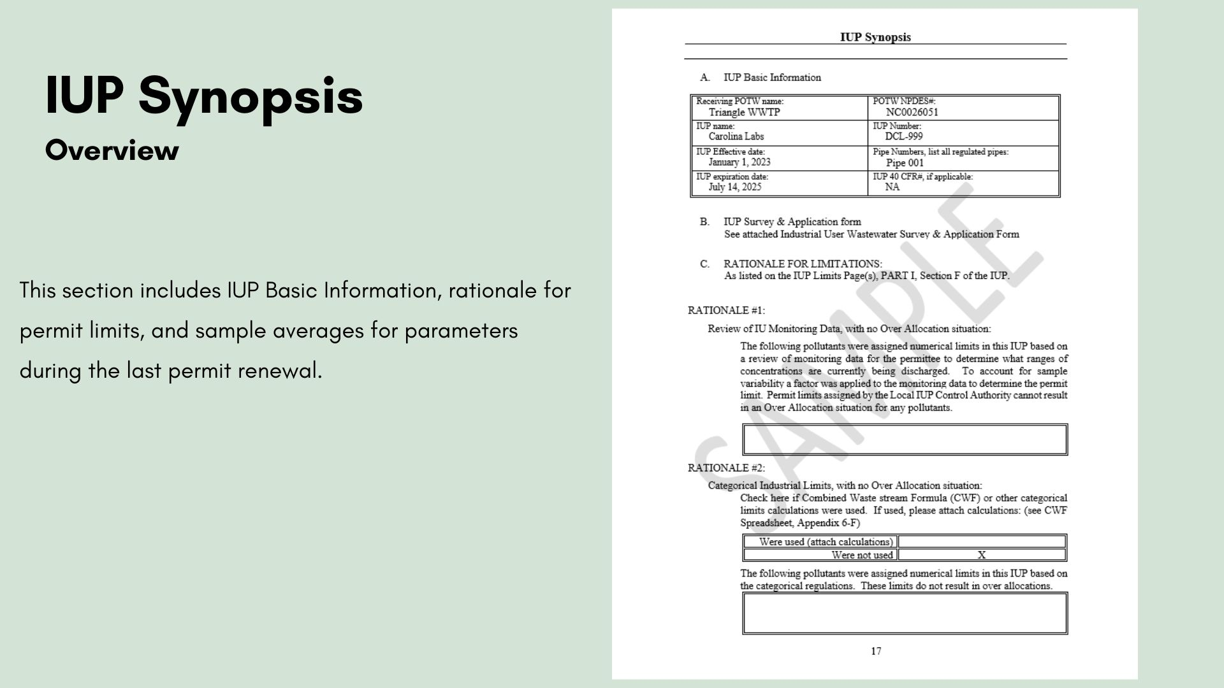

Slide 27
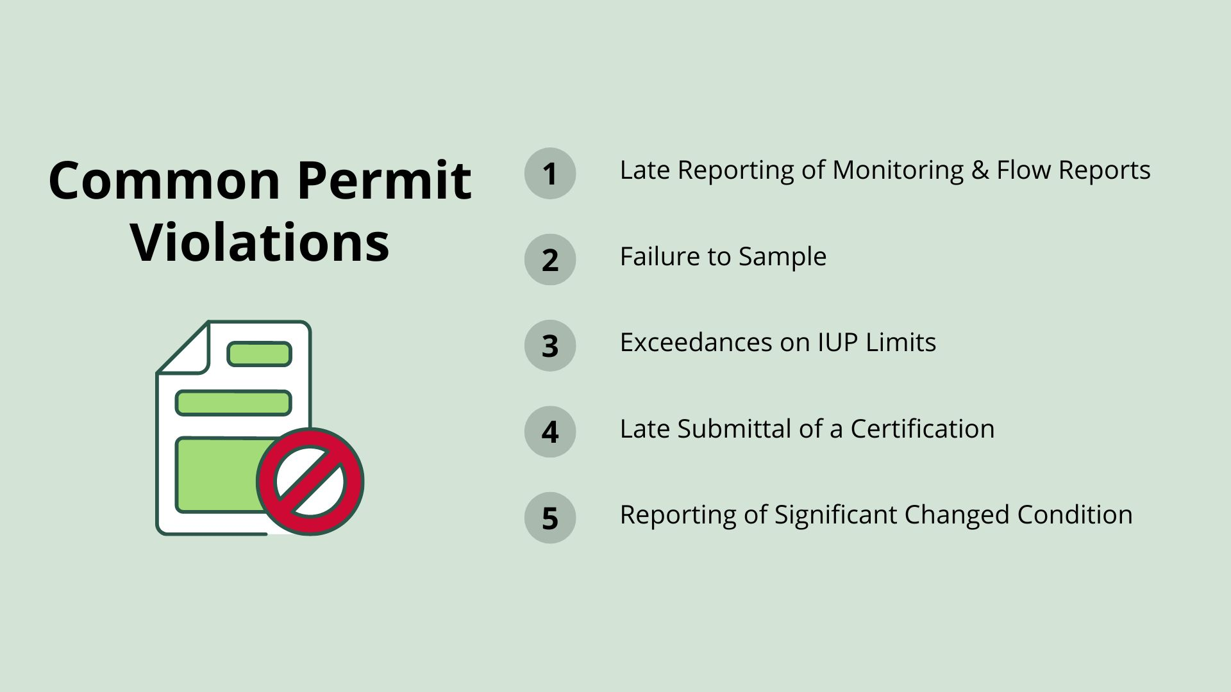

Slide 28
Late Reporting of Monitoring and Flow Reports
Reports are due the last day of the following month.
Make sure calculations are done correctly.
Average gallons per day formula = total monthly flow (gallons)
total number of days in the month (days).

Slide 29
Failure to Sample
Check with your contract labs and review lab reports.
It is the responsibility of the permittee to meet the requirements of their permit.

Slide 30
Exceedances on IUP Limits
The permittee is required to notify Durham County within 24 hours of becoming aware of the exceedance. (i.e., Receiving the Lab Report, Receiving a Phone Call from the Lab, Reading Flow Meter, etc.)
Use the form “Industrial Self-Monitoring Permit Violation Notification”, available on the website

Slide 31
Late Submittal of a Certification
Biosafety Decontamination Certifications are due by June 30th and December 31st each year.
Solids Interceptor Certifications are due monthly.
Flow meter calibration reports are due annually (between January 1st and December 31st ) shall be submitted within 15 days of calibration.

Slide 32
Reporting on a Significant Changed Condition
Permittees are required to report a significant changed condition at least 30 days prior to making the change and must receive approval from Durham County before making the change.
A list of significant changed conditions can be found in Part II.25 of IUP.

Slide 33

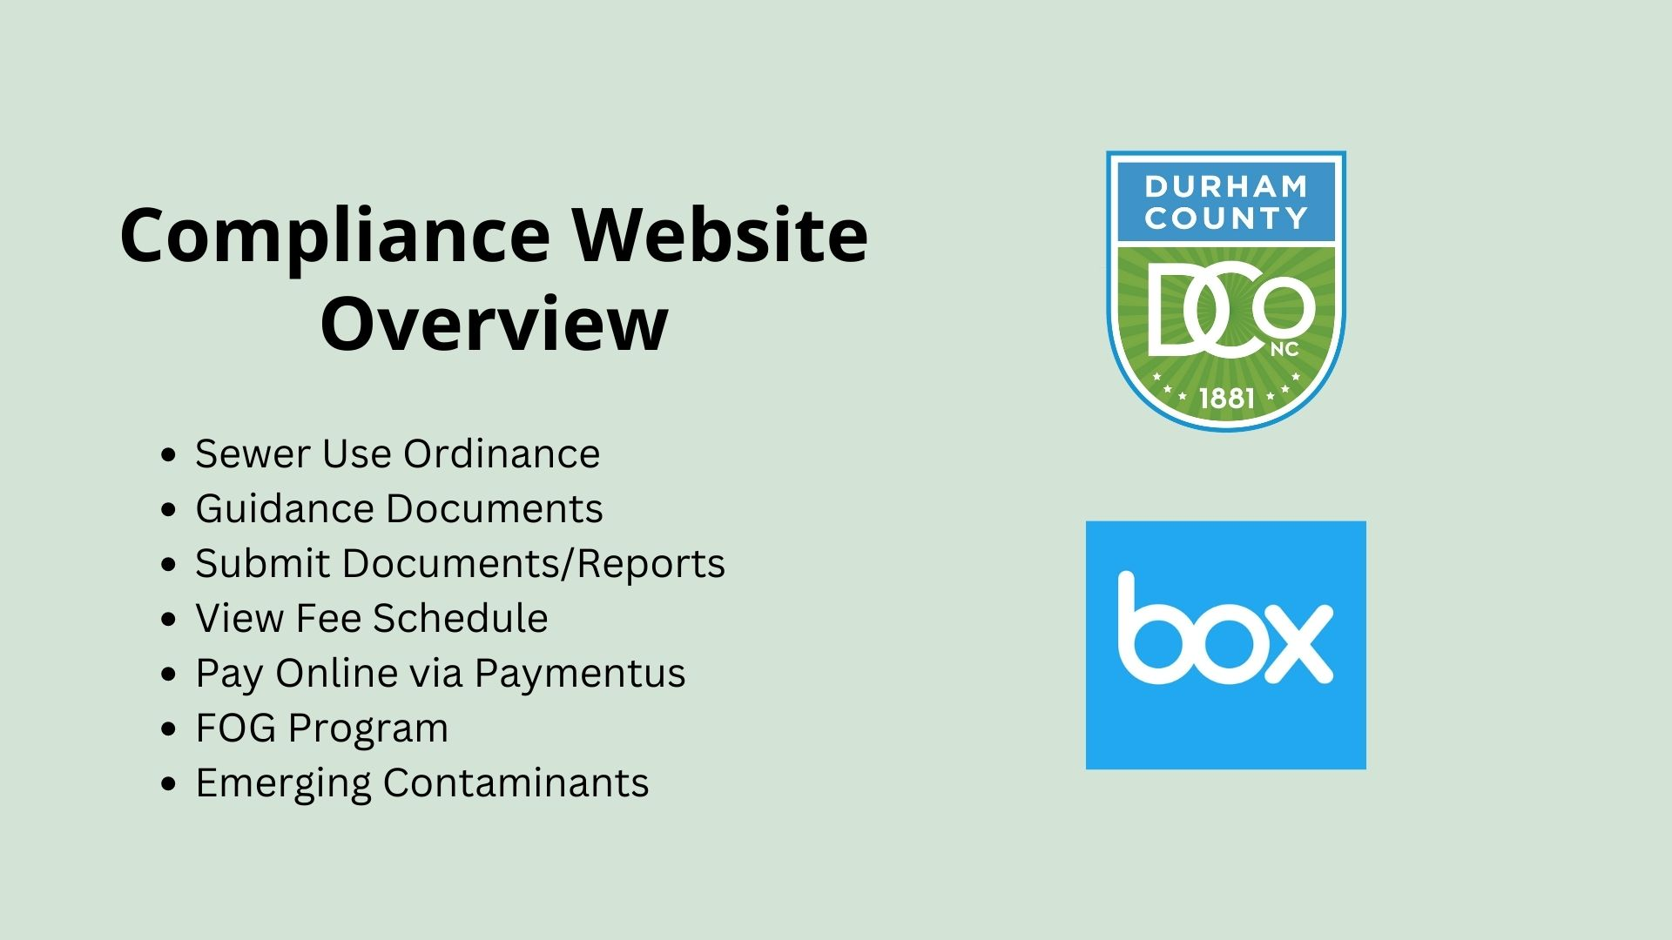

Slide 34
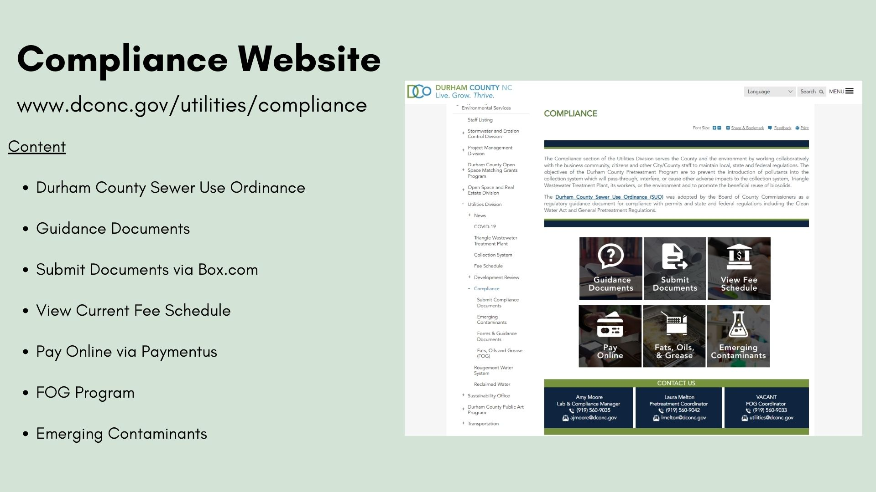

Slide 35
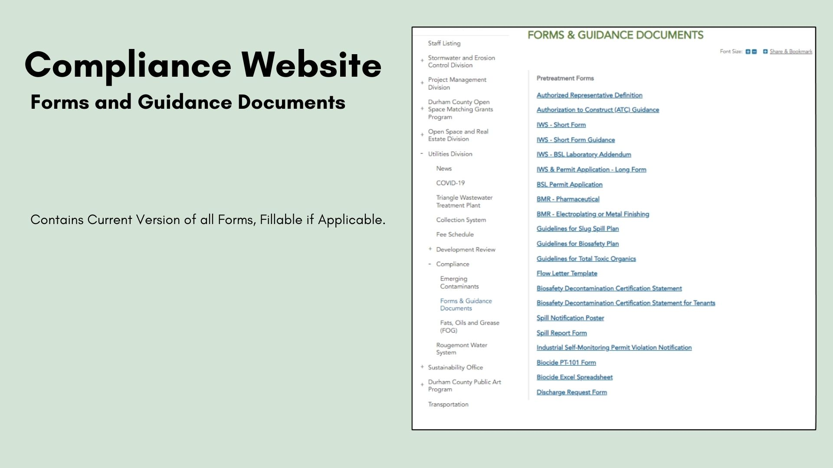

Slide 36
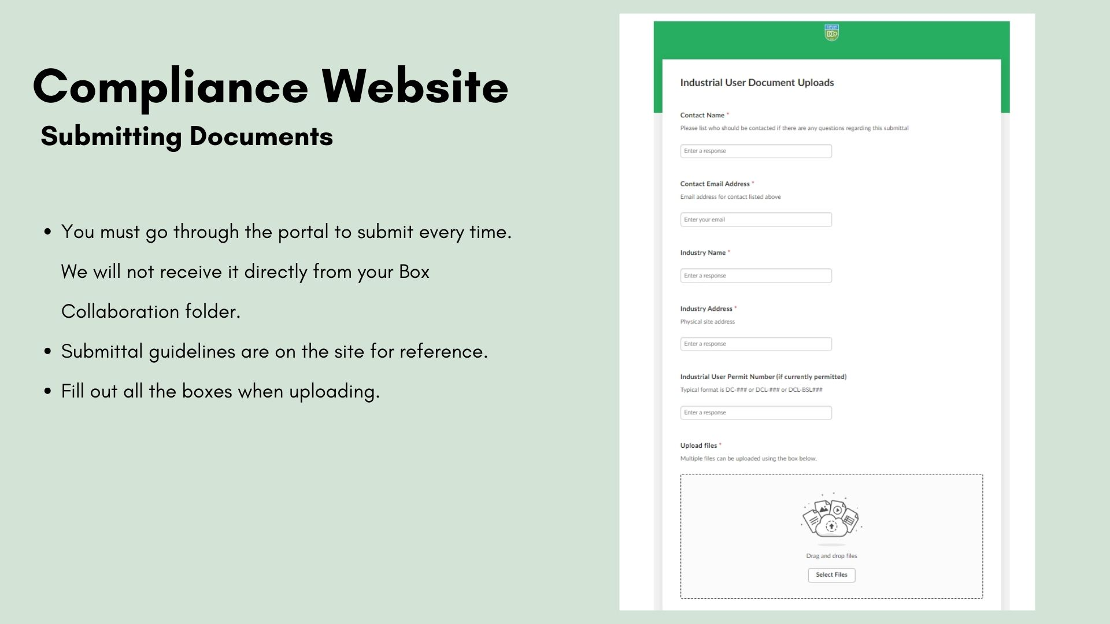

Slide 37
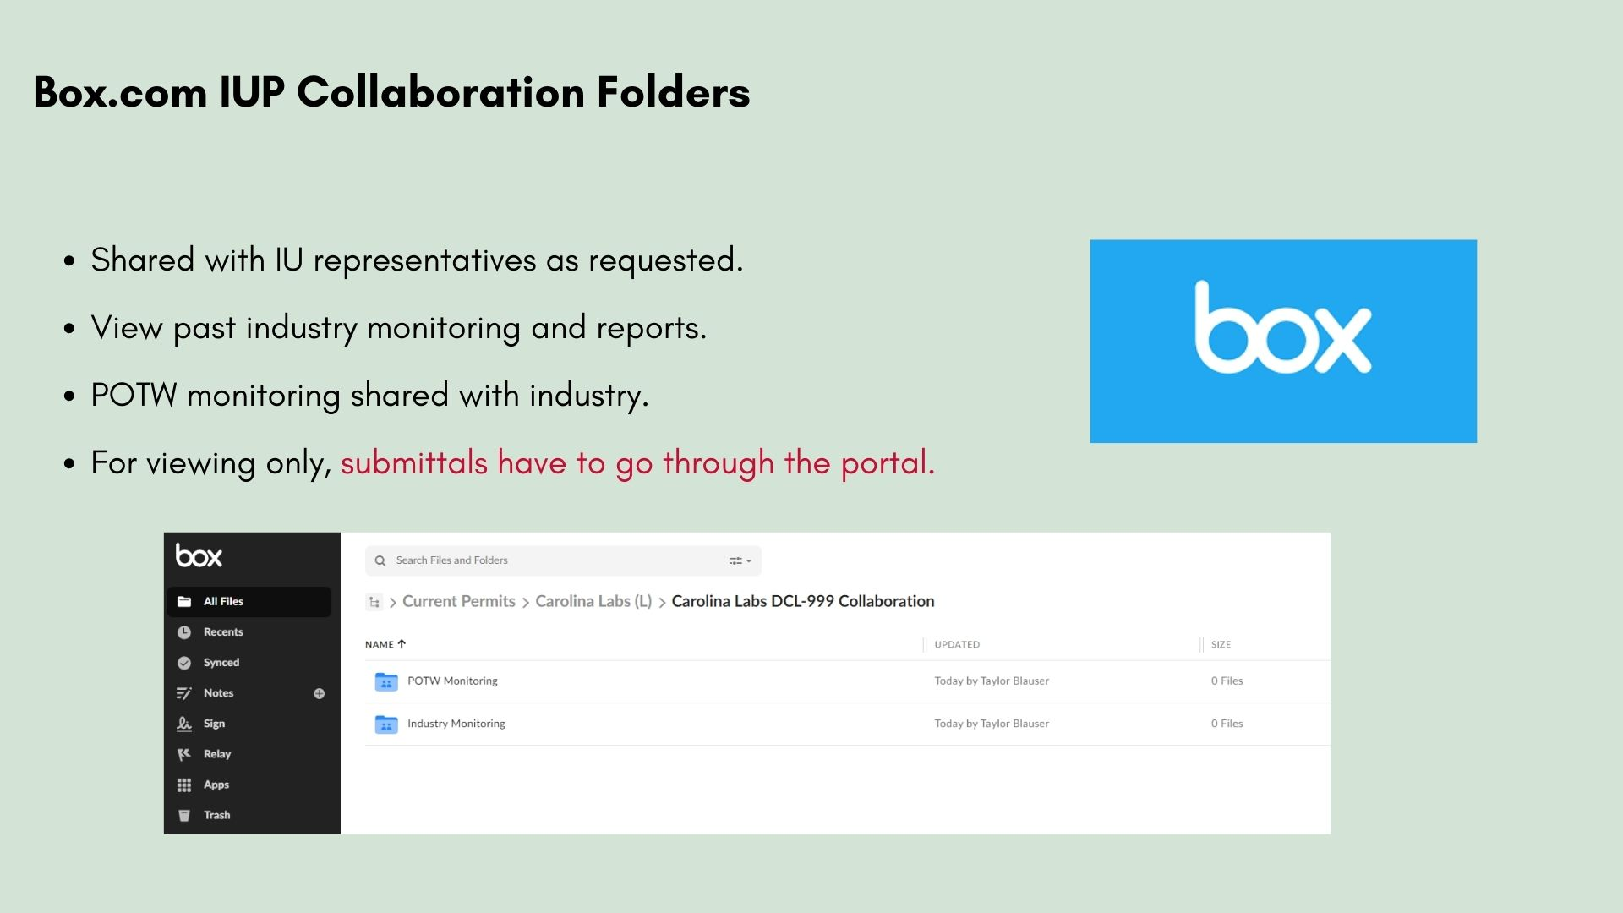

Slide 38
